Slide 1
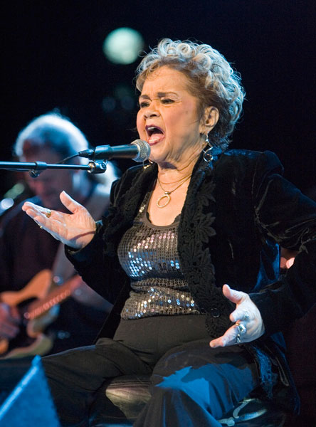
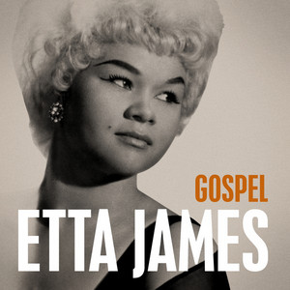
Musician of the Month – Etta James
September
Famous pieces:
O happy day
This little light of mine
Swing low sweet chariot
FACTS:
1960s – 1980s American
Considered to be “one of the greatest voices of her century”; famous for her deep and earthy voice
As well as a gospel and soul singer, she also performed jazz, rock n roll, R&B and blues

Slide 2
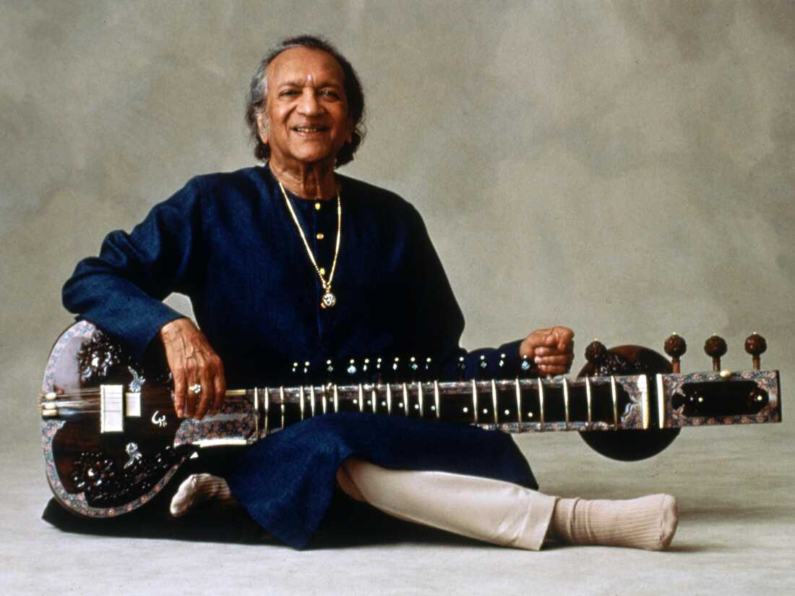
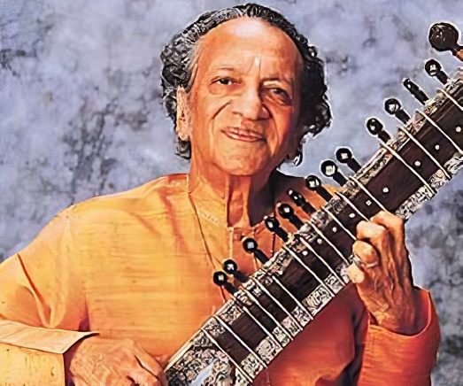
Musician of the Month – Ravi Shankar
October
Famous pieces:
Three Ragas
Theme to Panther Panchali
Raga Palas Kafi
FACTS:
1920 – 2012 Indian classical music
A sitar virtuoso (expert); he played and composed music for the sitar
Composer and founder of the National Orchestra of India
He continued to perform until the end of his life

Slide 3
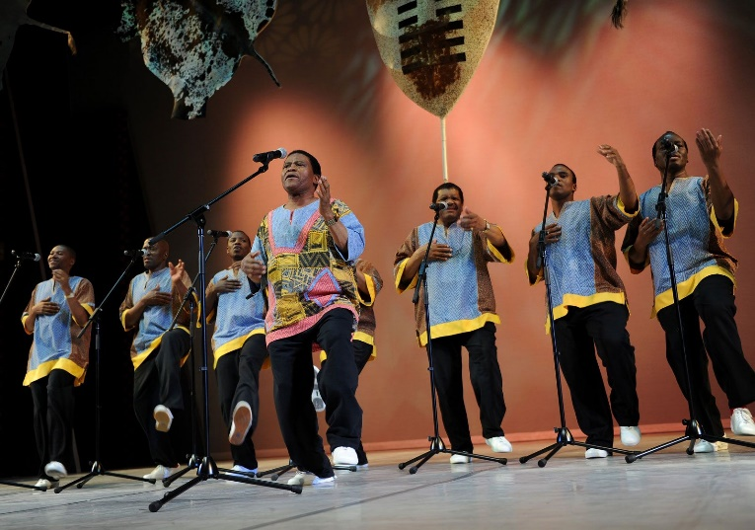
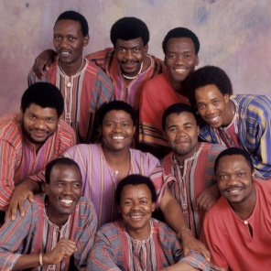
Musician of the Month – Ladysmith Black Mambazo
November
Famous pieces:
Homeless
Hello my baby
Inkanyezi Nezazi
FACTS:
1960 – present. South African A Cappella
An all male group singing in the traditional style of the Zulu people
The group are all relatives, mostly brothers and cousins
Ladysmith = their home town.
Black = the strongest of all farm animals, the black ox.
Mambazo = the Zulu word for axe, a symbol of the group's vocal strength.

Slide 4
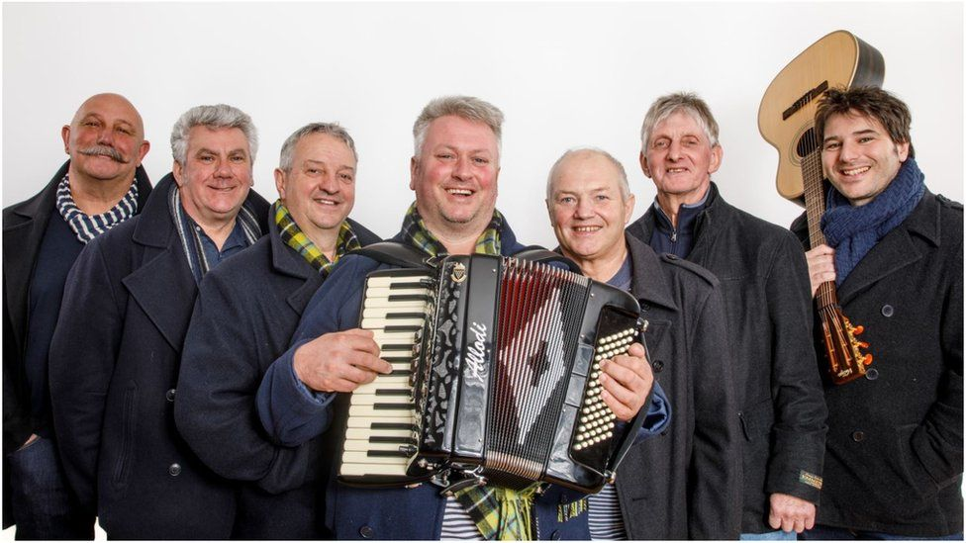
Musician of the Month -Fisherman’s Friends
December
Famous pieces:
John Kanaka
The leaving shanty
Keep hauling
FACTS:
1995 – present. British Folk
A folk music group from Port Isaac in Cornwall who sing sea shanties
Often a cappella, sometimes with simple instrumentation
The group consists of two brothers and their friends

Slide 5
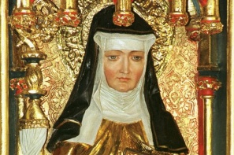
Musician of the Month -Hildegard
January
Famous pieces:
Ordo Virtutum
A feather on the breath of God
Heavenly revelations:
FACTS:
1098 – 1179(Middle ages) Classical (early)
German
One of the first identifiable composers in the history of Western music
At age 8 she was sent to a monastery where she spent the next 40 years of her life
Famous for her hymns & chants

Slide 6
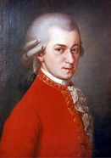
Musician of the Month – Mozart
February
Famous pieces:
Duettino- Sull'aria
Eine Kleine Nachtmusik
Rondo Alla Turca
FACTS:
1756 – 1791. Austrian Classical
He is one of the most influential and popular classical musicians of all time
He composed over 600 works for the orchestra, voice and piano

Slide 7
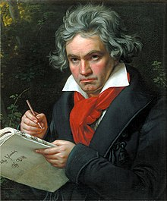
Musician of the Month – Beethoven
March
Famous pieces:
Moonlight Sonata
Fur Elise
Symphony No. 5
FACTS:
1770 – 1827. German Classical
Widely regarded as the greatest composer who ever lived
Composed 722 works for the orchestra and piano
By the time he was 45 he was totally deaf, but continued to compose music

Slide 8
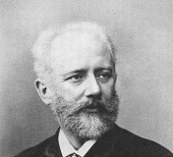
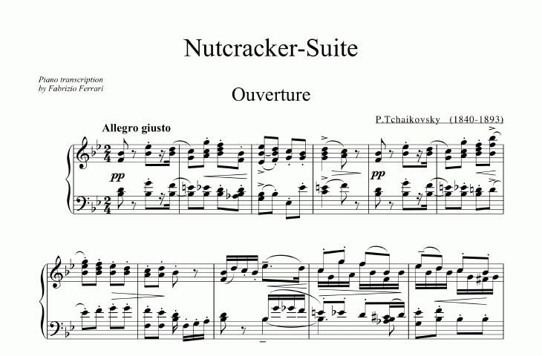
Musician of the Month – Tchaikovsky
April
Famous pieces:
“The Dance of the Sugar Plum Fairy” (Nutcracker )
Swan Lake
1812 Overture
FACTS:
1840 – 1893. Russian Classical (Romantic)
He wrote some of the most popular classical music including 3 ballets (The Nutcracker, Swan Lake, Sleeping Beauty)

Slide 9
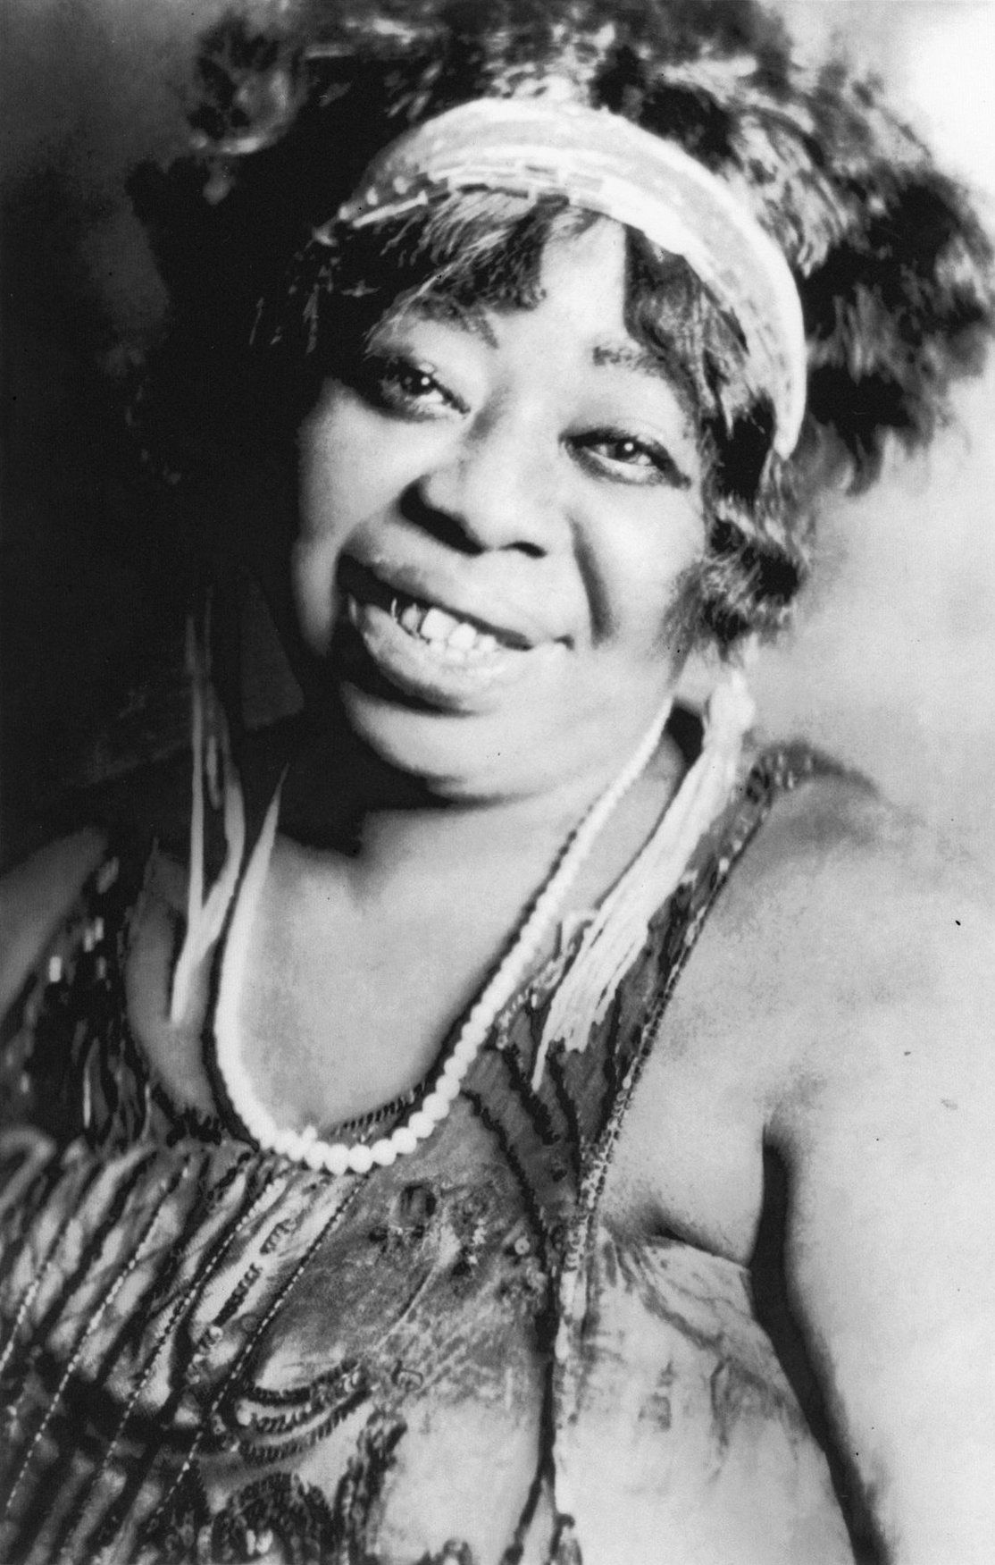
Musician of the Month – Ma Rainey
May
Famous pieces:
Jealous hearted blues
Moonshine blues
Soon this morning
FACTS:
1886 – 1939. American Blues
Known as “The Mother of Blues”
One of the earliest recorded blues musicians
She made almost 100 records

Slide 10
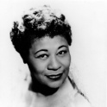
Musician of the Month – Ella Fitzgerald
June
Famous pieces:
How high the moon
Dream a little dream of me
One note samba
FACTS:
1917 – 1996. American Jazz
Referred to as the "First Lady of Song", "Queen of Jazz", and "Lady Ella"
Famous for her ability to improvise; particularly in her scat singing (wordless improvisation)

Slide 11
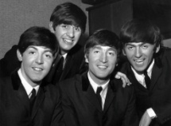
Musician of the Month – The Beatles
July
Famous pieces:
Imagine
Let it be
Hey Jude
FACTS:
1960s – 1970s. British Pop/Rock
The best selling music act of all time
They have the most number 1 hits of all time (20)
The “Fab Four”: John Lennon, Paul McCartney, George Harrison, Ringo Starr

