Slide 1
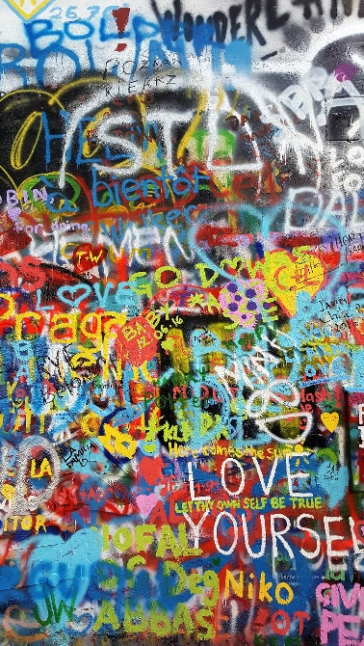
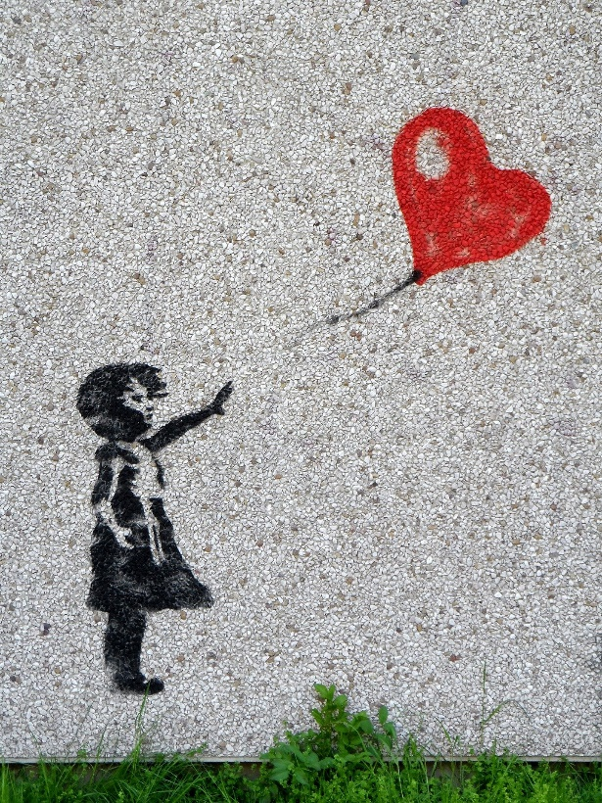
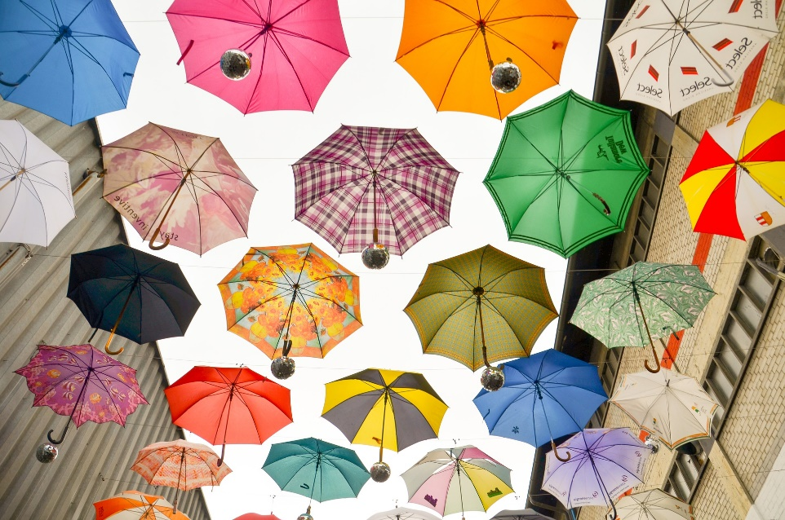
What Is Street Art?
Street art is artwork that has been created in a public place. It might not be a permanent piece.

Slide 2
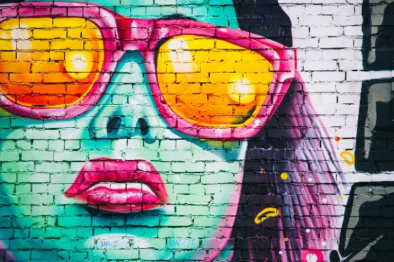
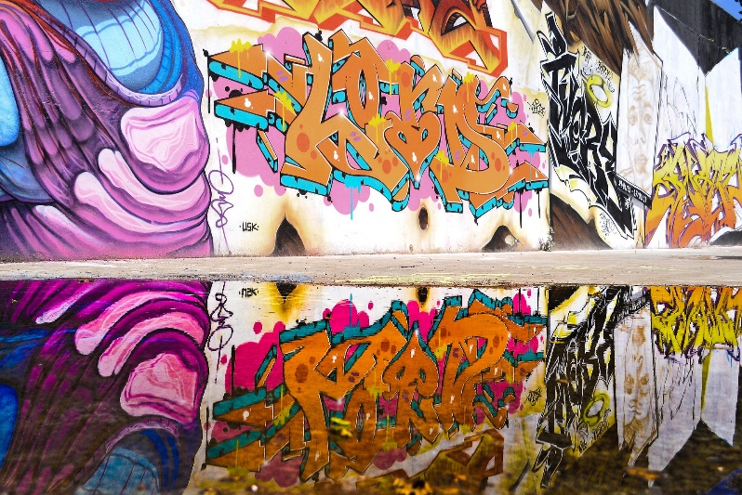
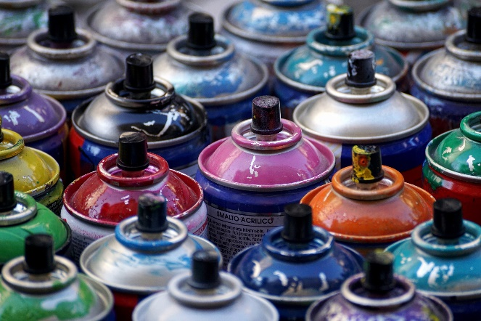
Graffiti
Graffiti is one type of street art. This is often writing or pictures sprayed onto walls in public places.
When graffiti artists don’t get permission to use a public space, their graffiti is illegal (against the law).
Some towns and cities have legal graffiti sites where artists can showcase their work.

Slide 3
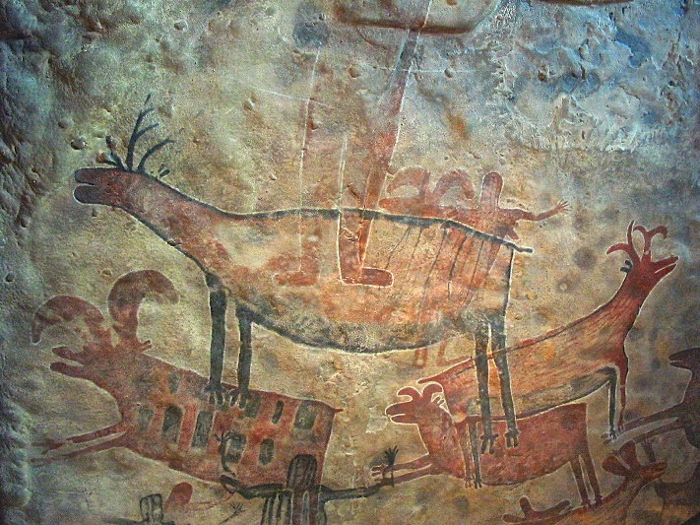
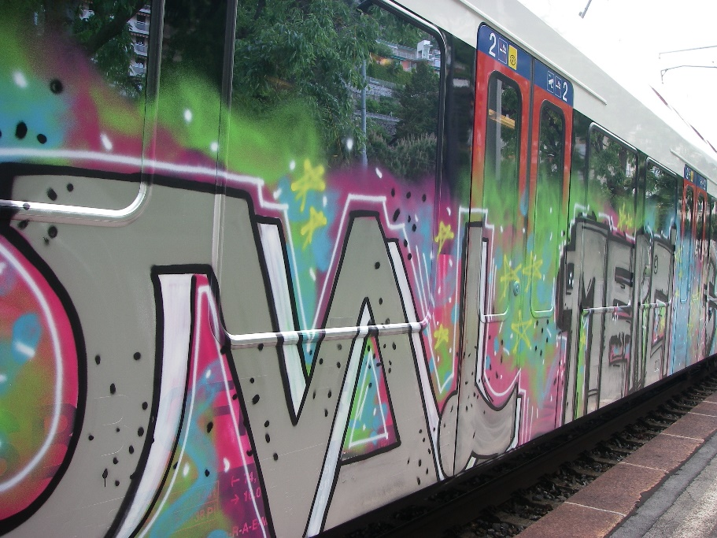
History of Graffiti
The first wall drawings appeared in caves thousands of years ago.
Modern graffiti started in the United States in the 1960s. By the late 1960s, it had reached New York. This new art form became very popular throughout the 1970s when artists began tagging buildings.
"Swiss train graffiti" by Richard Allaway is licensed under CC BY 2.0
Soon after, underground trains could be seen covered in spray paint and became a popular place for ‘taggers’ to write.

Slide 4
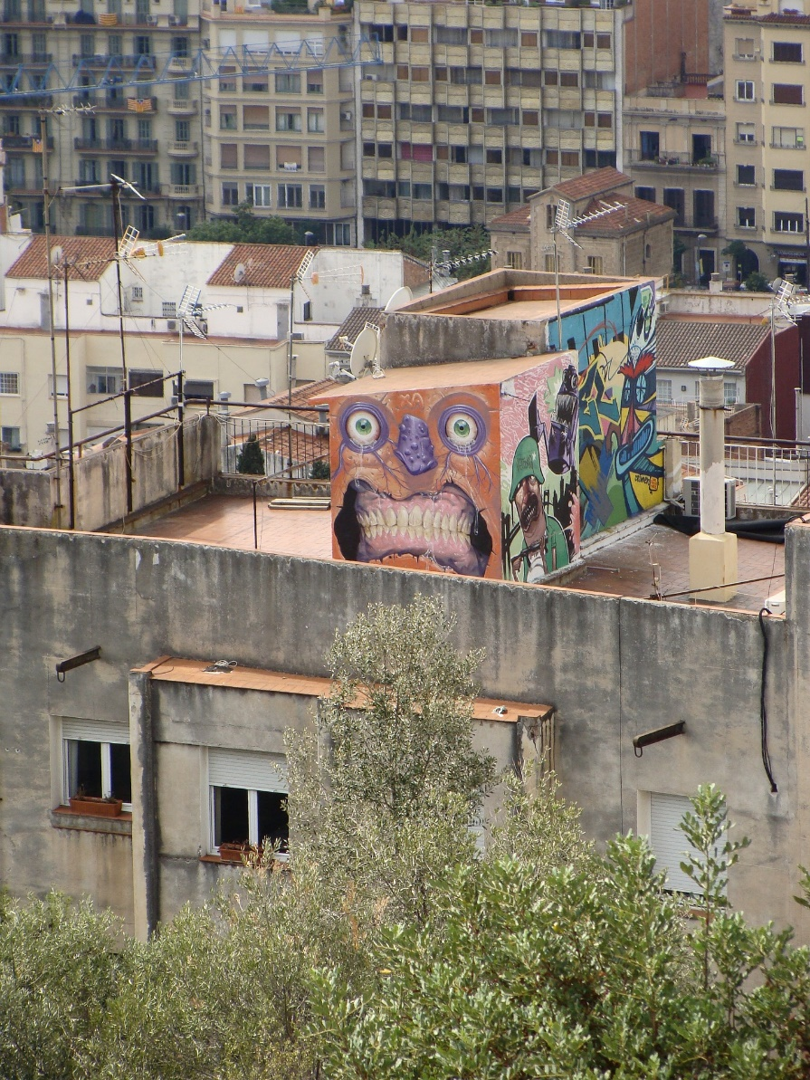
History of Graffiti
Tags were a way of gangs marking their territory. They worked in groups called ‘crews’. New York art galleries starting buying graffiti art at the same time that the mayor of New York spoke out about how he was against it.
During the 1980s, many graffiti artists began using roofs or canvases for their art. Even today, the debate over whether graffiti is vandalism or art is still being discussed.

Slide 5
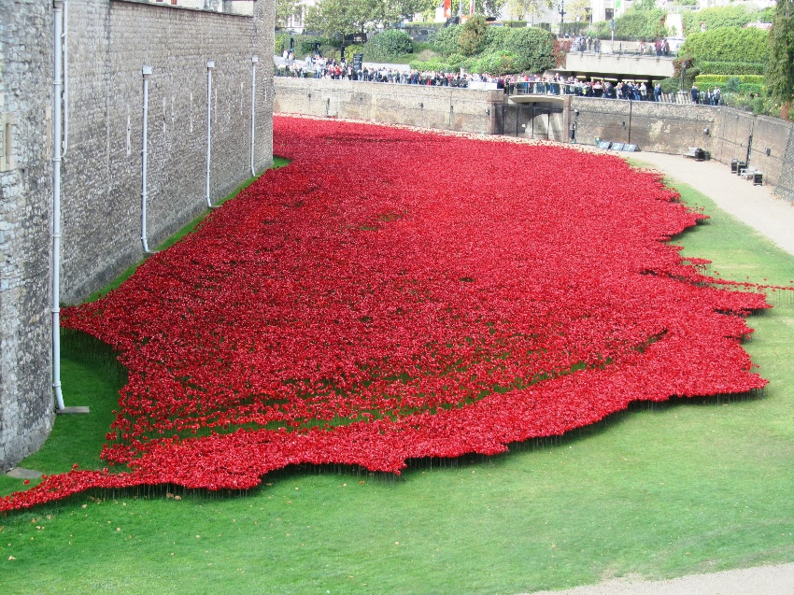
Art Installations
Art installations are another example of street art. These are organised art exhibitions and they are not illegal.
This image shows the public art installation, Blood Swept Lands and Seas of Red, which commemorated the centenary of the outbreak of the First World War.
As part of the installation, 888,246 ceramic poppies were made - one to remember each British soldier killed in the war.

Slide 6
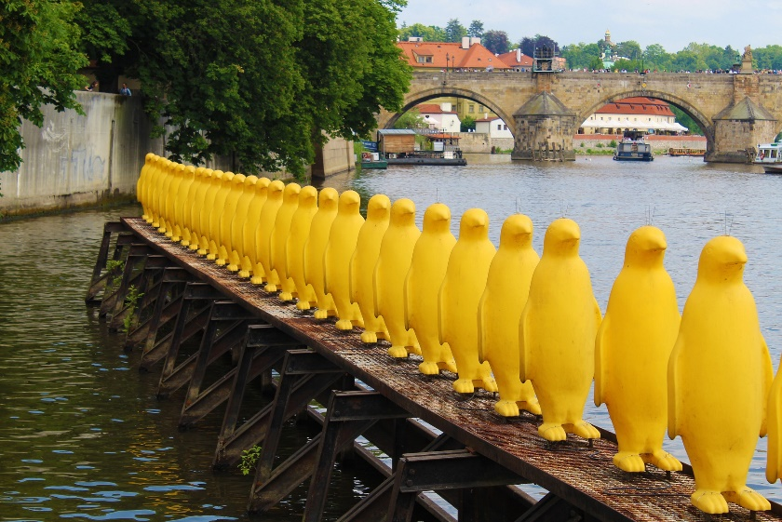
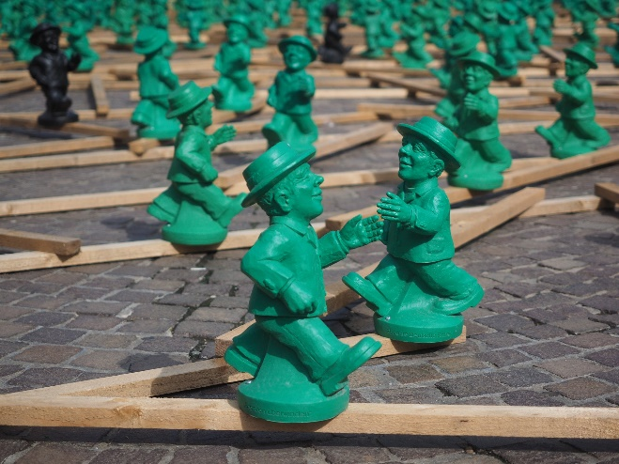
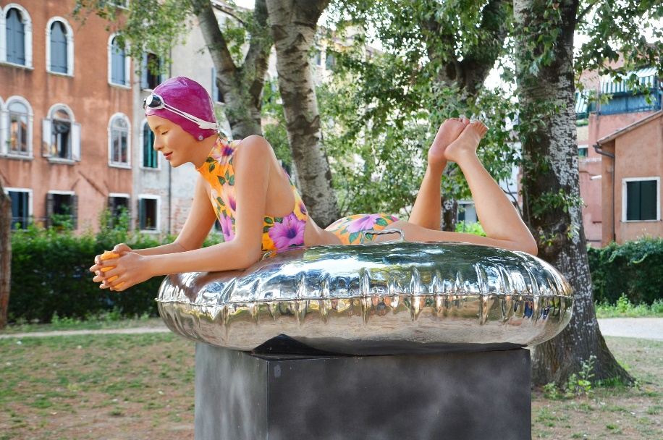
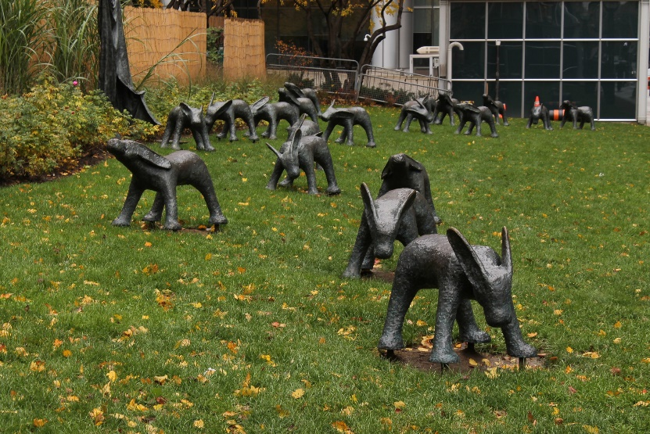
Art Installations
Here are some examples of street art installations around the world.

Slide 7
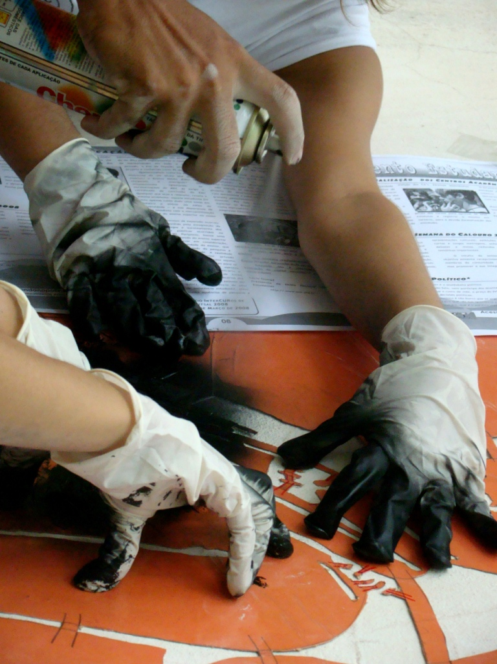
Stencil Art
Another example of street art is stencil graffiti. A stencil is a piece of paper, metal or plastic which has a design, pattern or words cut out of it. The artist rests it up against the surface and fills it in with paint, before removing it.
”Stencil" by Clara . is licensed under CC BY 2.0

Slide 8
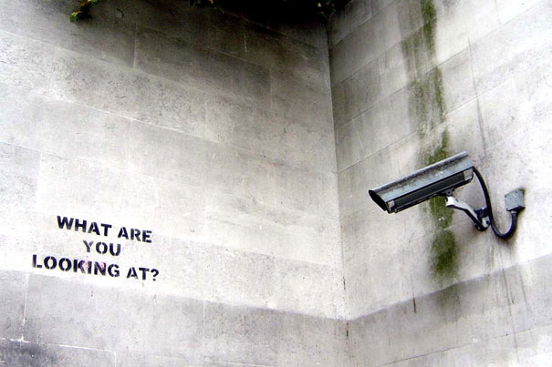
Banksy
A lot of Banksy’s work is done using stencils. Banksy is very famous but nobody knows his true identity, as he keeps it a secret.
His work is often political or humorous. He uses art to expresses his own opinions.
What do you think he was trying to express in
this piece?
”banksy-graffiti-street-art-what-are-you-looking-at" by Bruce Krasting is licensed under CC BY 2.0

Slide 9
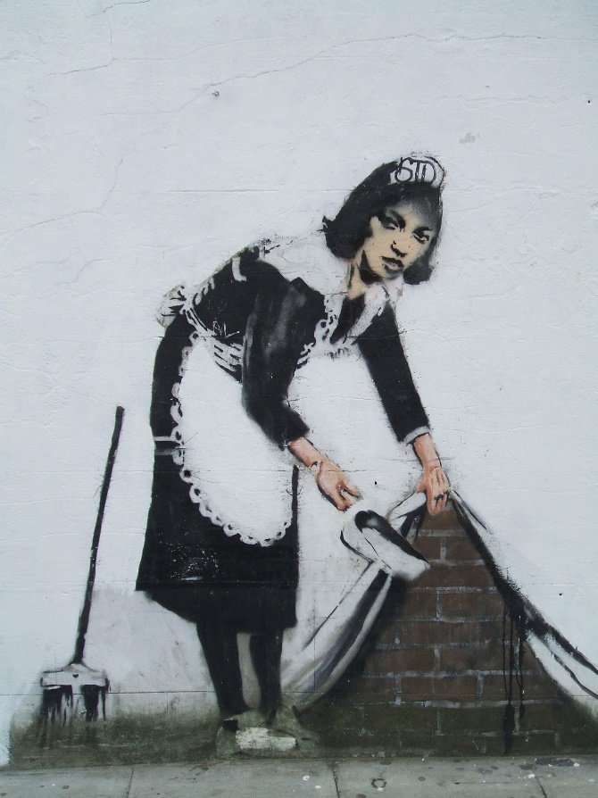
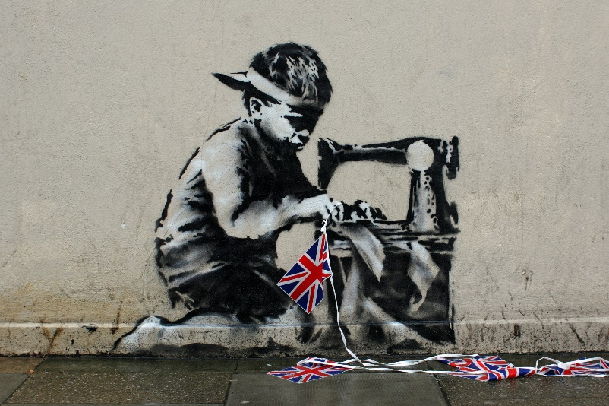
Banksy
His work appears in public places; this has caused controversy, as he uses illegal graffiti sites to showcase his work. His art is admired around the world but, at the same time, he is breaking the law.
Do you think this art is vandalism (damaging public property)? Discuss this with your partner.
”Banksy?" by moufle is licensed under CC BY 2.0
Did You Know...?
Banksy’s art has sold for over £1,000,000.
”Banksy" by DeptfordJon is licensed under CC BY 2.0

Slide 10
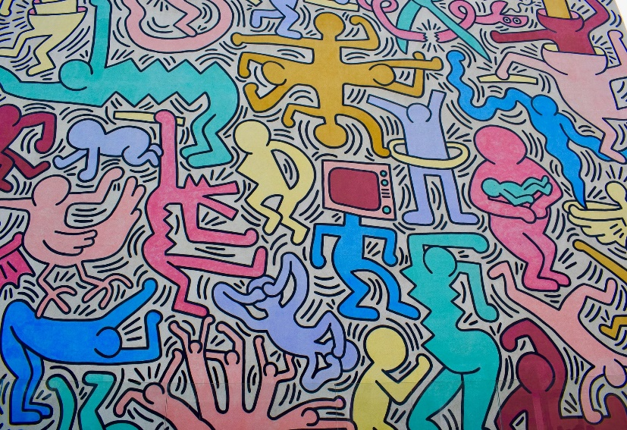
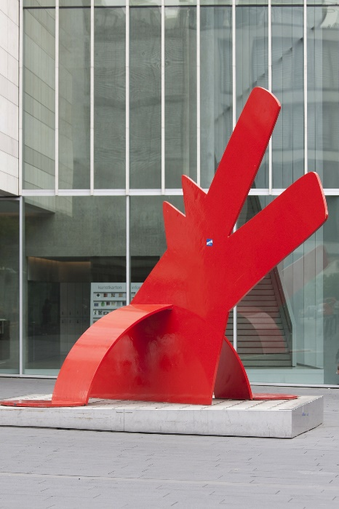
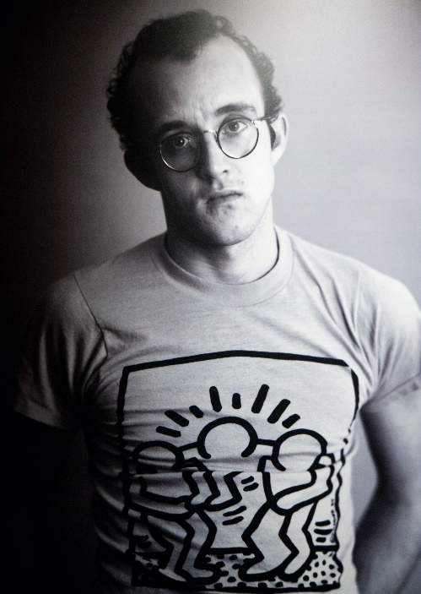
Keith Haring
Another famous street artist was Keith Haring. He was well known for his bold and bright street art and sculptures. His work has a cartoon-like style.
During the 1980s, he showcased his art in France, Australia and Germany, where he painted part of the Berlin Wall.
The Berlin Wall was built to separate East and West Germany. The majority of the wall was knocked down in 1989 so that it no longer functioned as a barrier. Some sections of the wall still stand and can be visited today.
"Keith Haring Extra Large @ Udine" by Andrea Sartorati
is licensed under CC BY 2.0

Slide 11
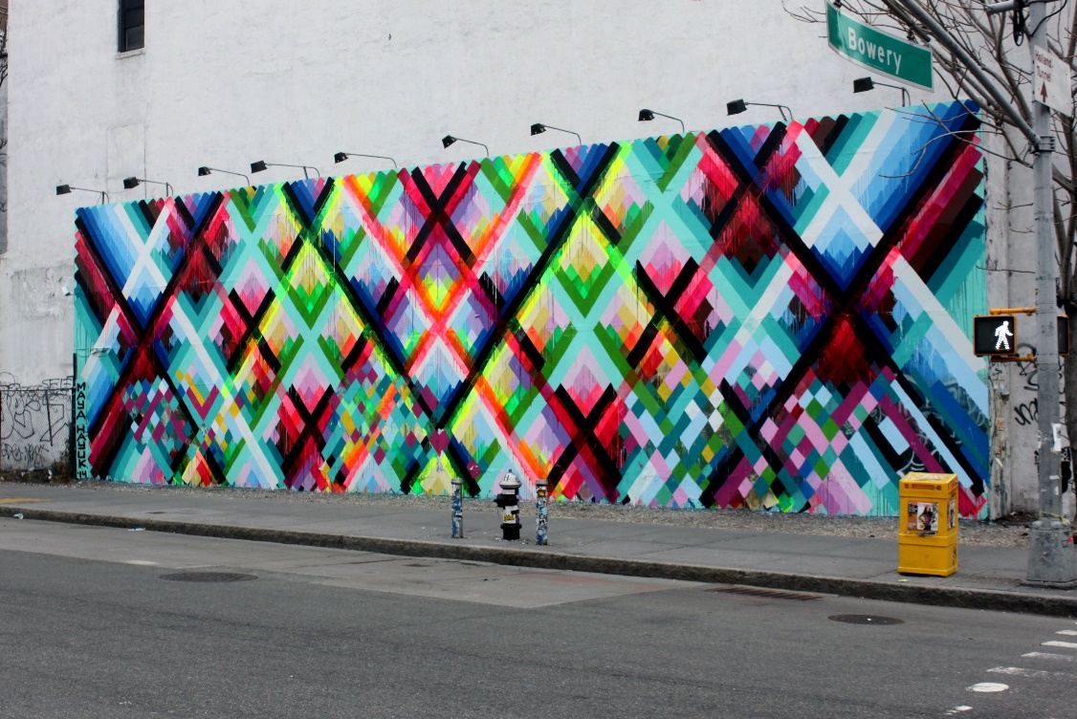
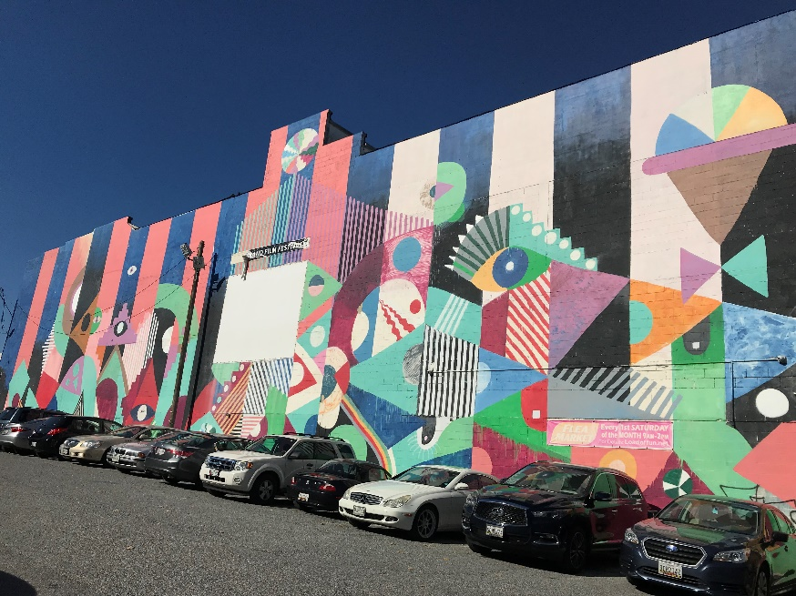
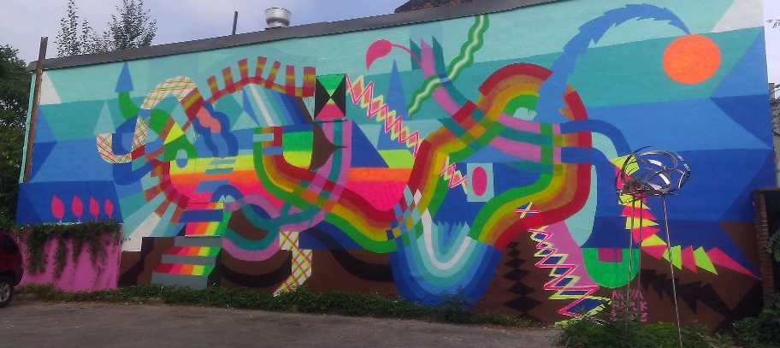
Maya Hayuk
Maya Hayuk’s work is known for its vibrant colours and bold geometric patterns.
"April 2014 (249)" by Lord Jim is licensed under CC BY 2.0
Maya Hayuk - Mural - MOCCA, Toronto" by bixentro is licensed under CC BY 2.0

Slide 12
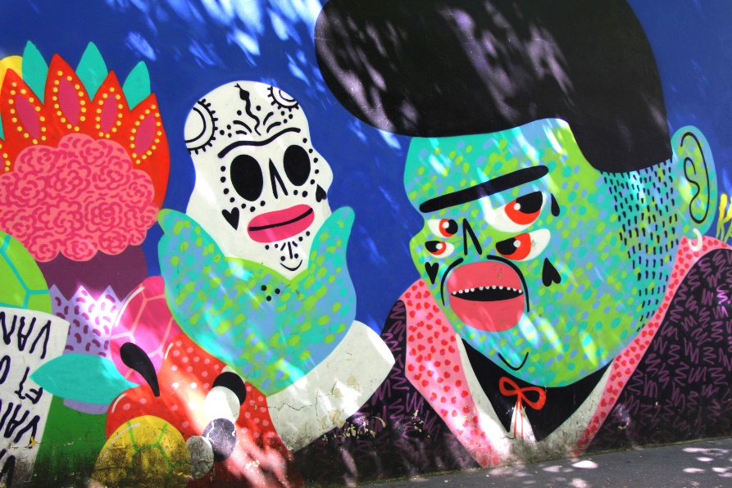
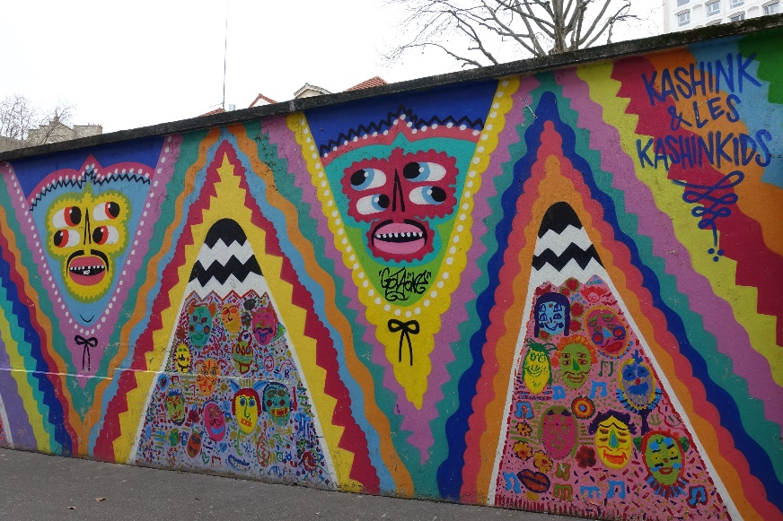
Kashink
Kashink, a female street artist from Paris, celebrates diversity and self-expression through painting huge murals all over the world.
"IMG_6389/Une Fresque en forme de ' Vanité ' par Women's Forum de la Graffeuse Kashink" by dany13 is licensed under CC BY 2.0
Although a lot of the murals she paints are commissioned, and completely legal, she still likes to take risks and create illegal artwork too.
"Kashink @ Street art @ Paris 13" by *_* is licensed under CC BY 2.0

Slide 13
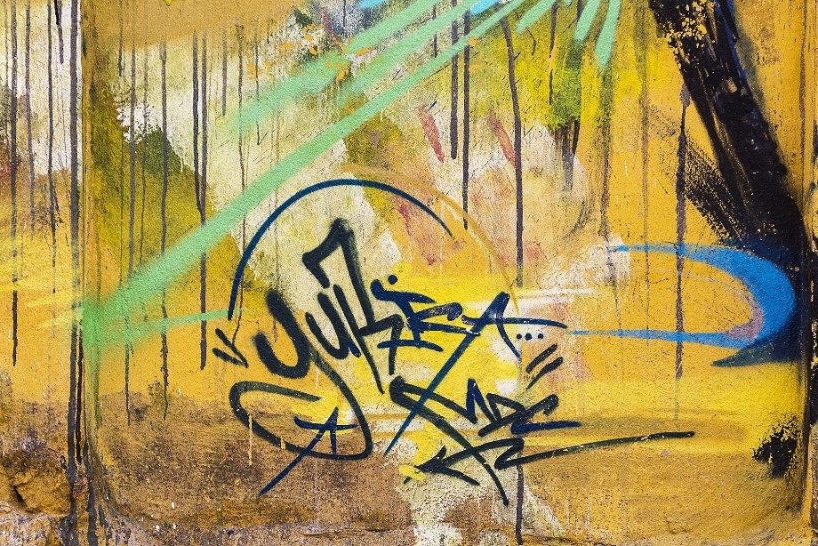
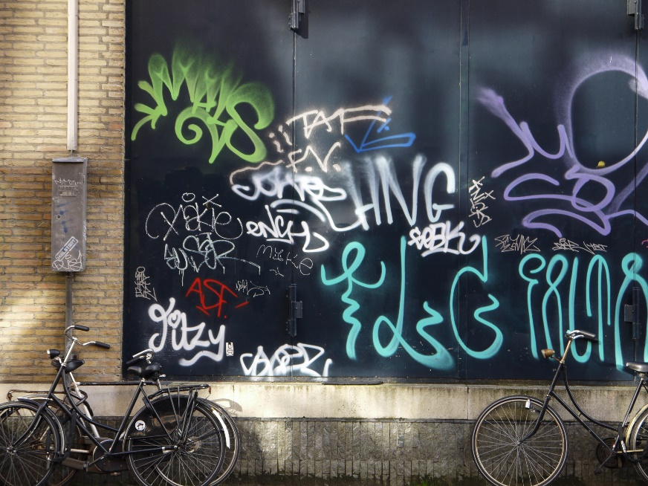
Tag
A tag is the most basic type of graffiti - it’s the artist’s signature. It’s usually written in spray paint or marker pen.
Can you create your own tag using your nickname or initials? The most important thing is to make it unique and use colours that you like.
Why do you think graffiti artists do not sign their work with their full name?

